Slide 1
Architecture Styles & Trade-Offs
From Best Architecture to Right Architecture

Slide 2
Misconceptions:
“Microservices are modern → we must use them”
“Clean Architecture everywhere”
Architecture chosen before understanding the problem
Reality:
Architectures exist to manage constraints, not to look elegant
Every architecture optimizes something and sacrifices something else
Software Architecture

Slide 3
Nature:
Single deployable unit
Shared codebase, shared database
Strengths:
Simple to understand
Easy to test end-to-end
Fast development early
Minimal operational overhead
Monolithic Architecture

Slide 4
Costs:
Tight coupling grows over time
Vertical Scaling
Deployment risk increases
Suitable for:
Early-stage products (or MVP)
Small teams
Low operational maturity
Need fast feedback
Note: A well-structured monolith is not a failure.
Monolithic Architecture …

Slide 5
Structure:
Presentation/ Controller
Application / Service
Domain / Core
Infrastructure / Data
What It Optimizes:
Separation of concerns
Team onboarding
Testability (to a degree)
Establishes a convention
Layered Architecture

Slide 6
Core Idea:
Domain at the center
Dependencies point inward
Benefits:
Domain independence
Infrastructure replaceable
Improved testability
Onion Architecture

Slide 7
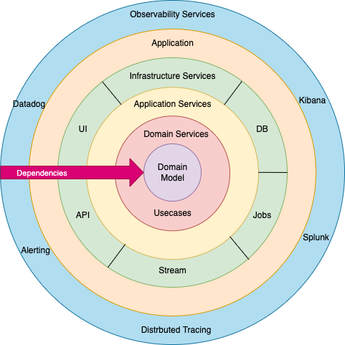
Onion Architecture … …

Slide 8
Key Concept:
Application core is isolated from external systems
Ports:
Interfaces the core defines
Adapters:
Implementations (DB, REST, MQ)
Best for:
systems with many diverse external integrations (APIs, message queues, multiple DB types) where flexibility at the edges is the priority.
Hexagonal Architecture (Ports & Adapters)

Slide 9
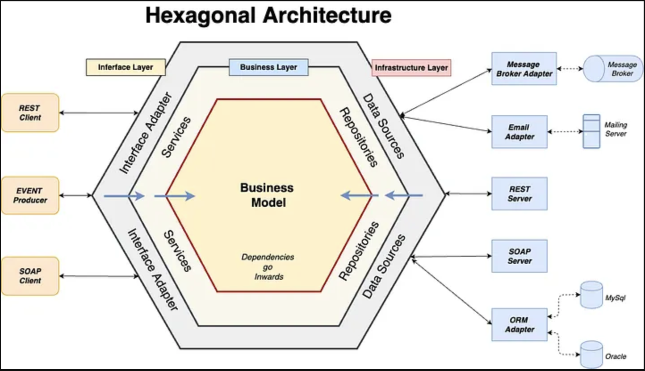
Hexagonal Architecture… …

Slide 10
Definition:
Having different Services
Each service solves a specific part of business not a technical domain like micro-service
Communicate over the network call
Shared database
Example: Account Service, Loan Service etc.
Benefits:
Centralized security & policy enforcement
Works well in regulated environments
Centralized control and governance
Service Oriented Architecture (SOA)

Slide 11
Definition:
Independently deployable services
Aligned to business capabilities
Bounded responsibilities for each service(micro)
Benefits:
Independent scaling
Fault isolation (in theory)
Easier to test
Microservices Architecture

Slide 12
They require:
Strong DevOps
Mature monitoring
Domain-driven boundaries (will cover it in later session)
When NOT to Use Microservices:
Small team
No DevOps automation
Unclear domain boundaries
Low traffic
Limited observability
Lack of standard practices
Microservices Reality Check

Slide 13
Core Idea:
Systems react to events
Service level loose coupling
Own data with independency
No network call but message bus
Eventual consistency
Cons:
Debugging high complexity
Event versioning
Eventual consistency
Event-Driven Architecture

Slide 14
There is no “best” architecture.
There is:
Best for requirements
Best for available resources (human, server, budget)
Best for failure management etc
Note: Architecture should evolve, not be married upfront.
Architecture as a Series of Trade-Offs

Slide 15
Thank you!

